Slide 1
HTML⁵

Slide 2
NUEVAS ETIQUETAS HTML
1
RESPECTO A VERSIONES ANTERIORES DE HTML

Slide 3
NUEVAS ETIQUETAS
<article> | Defines an article.
<audio> | Embeds a sound, or an audio stream in an HTML document.
<bdi> | Represents text that is isolated from its surrounding for the purposes of bidirectional text formatting.
<data> | Links a piece of content with a machine-readable translation.
<datalist> | Represents a set of pre-defined options for an <input> element.
<details> | Represents a widget from which the user can obtain additional information or controls on-demand.
<dialog> | Defines a dialog box or subwindow.
<embed> | Embeds external application, typically multimedia content like audio or video into an HTML document.
<figcaption> | Defines a caption or legend for a figure.
<figure> | Represents a figure illustrated as part of the document.
<hgroup> | Defines a group of headings.
<keygen> | Represents a control for generating a public-private key pair.
<mark> | Represents text highlighted for reference purposes.
<menuitem> | Defines a list (or menuitem) of commands that a user can perform.
<meter> | Represents a scalar measurement within a known range.
<output> | Represents the result of a calculation.
<picture> | Defines a container for multiple image sources.
<progress> | Represents the completion progress of a task.
<rp> | Provides fall-back parenthesis for browsers that that don't support ruby annotations.
<rt> | Defines the pronunciation of character presented in a ruby annotations.
<ruby> | Represents a ruby annotation.
<source> | Defines alternative media resources for the media elements like <audio> or <video>.
<summary> | Defines a summary for the <details> element.
<time> | Represents a time and/or date.
<video> | Embeds video content in an HTML document.
<wbr> | Represents a line break opportunity.

Slide 4
NUEVAS ETIQUETAS
<dialog open>
<p>Esto es una ventaja emergente
¿Conocías esta etiqueta?</p>
<button type="button">Si</button>
<button type="button">No</button>
</dialog>
<details open>
<summary>¿Quién es Alejandro?</summary>
<p>Aún no se ha descubierto publicamente, pero podrás averiguarlo con el tiempo</p>
</details>
Se utiliza para crear ventanas emergentes
Se utiliza para mostrar un widget interactivo que permite mostrar más información
<DIALOG>
<DETAILS> <SUMARY>
<ul>
<li><data value="100">Tomate</data></li>
<li><data value="110">Nata</data></li>
<li><data value="111">Oregano</data></li>
</ul>
<audio controls autoplay loop muted>
<source src="Recursos/Cancion1.mp3" type="audio/mp3">
</audio>
Vincula un contenido dado con una traducción legible por una máquina
Embebe una pista de audio en la página web
<DATA>
<AUDIO>

Slide 5

NUEVAS ETIQUETAS
<picture>
<source media="(max-width: 500px)“ srcset="Recursos/circulo.png">
<source media="(max-width: 1200px)" srcset="Recursos/pentagono.png">
<img src="Recursos/cubitos.png">
</picture>
<ruby>
&#28450; <rp>(</rp><rt>Kan</rt><rp>)</rp>
&#23383; <rp>(</rp><rt>ji</rt><rp>)</rp>
</ruby>
RP. Propociona paréntesis de respaldo a los navegadores.
RT. Se utiliza para definir la pronunciación dentro de Ruby.
Permite al desarrollador otorgar de flexibilidad para mostrar una imagen u otra en función de ciertos parámetros
<RUBY> <RP> <RT>
<PICTURE> <SOURCE>
<video controls="controls" muted <!–autoplay--> loop poster="Recursos/Imagen1.jpg" height="300" width="500">
<source src="Recursos/Video1.webm" type="video/webm"> Tu navegador no soporte este elemento</video>
<p>PalabraHiperMegaLargaPalabraHiperMegaLarga<wbr>SiguiendoLaPalabra preparado para abordar el<p>
Se utiliza para reproducir un vídeo
Sirve para establecer un punto de ruptura en caso de que haga falta en caso de palabras muy largas
<VIDEO>
<WBR>

Slide 6
NUEVAS ETIQUETAS
<hgroup>
<h1>Titulo 1</h1>
<h2>Titulo 2</h2>
</hgroup>
<figure legend="Recursos">
<img src="Recursos/Imagen1.jpg" alt="Imagen de Programación">
<figcaption>Prueba del uso de FIGURE (Subtitulos)</figcaption>
</figure>
Se usa para tratar un conjunto de títulos
Permite establecer una foto y un subtítulo dentro de un mismo grupo de etiquetas
<HGROUP>
<FIGURE> <FIGCAPTION>
<time datetime="2022 15-08">15 Agosto</time>
<TIME>
Representa el tiempo en un formato legible por un ordenador
<progress id="bar" value="3" max="34"></progress>
<meter value="0.98"></meter>
Se utiliza para establecer una barra de progreso (Dinámica)
Se utiliza para establecer una barra de progreso (Estática)
<PROGRESS>
<METER>

Slide 7
NUEVAS ETIQUETAS
No se incluye MENUITEM puesto que solo se admite en Firefox
<input type="text" list="Miembros" name="favorite_browser">
<datalist id="Miembros">
<option value="Alejandro">
<option value="Sergio">
<option value="Antonio">
<option value="Serafina">
<option value="Toni">
</datalist>
Permite mostrar unas preferencias de selección
<DATALIST>
<bdo dir="rtl">Alejandro y sus <bdi>Alejandradas</bdi></bdo>
<embed type="text/html" src="https://www.marca.com" width="500" height="200">
Permite mantener inalterable la dirección del texto
Permite embeber objetos dentro de una etiqueta
<BDI> <BDO>_{[No novedad]}
<EMBED>
<label>Encryption: <keygen name="key"></label>
<p>Pestaña Novedosa en <mark>HTML5</mark></p>
Genera una clave encriptada para enviar al servidor
Permite remarcar (algo similar a SPAN) pero con estilos por defecto
<KEYGEN>
<MARK>

Slide 8
TODOS LOS INPUTS
2
RESPECTO A VERSIONES ANTERIORES DE HTML

Slide 9



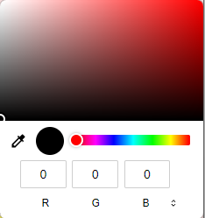

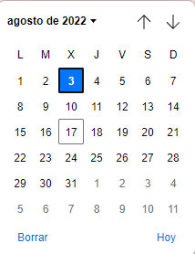
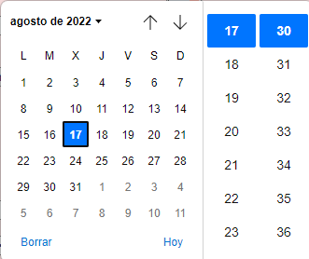





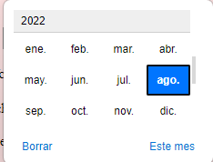
NUEVOS INPUTS
Tipos de Inputs | Descripción | Visualización
Text (Por defecto) | Entrada de campo de texto
Button | Usado para activar una script normalmente
Checkbox | Define un checkbox
Color | Define una selección de colores
Date | Define una fecha (año, mes, día)
Datetime-loca | Similar a Date pero con horario
Email | Define un campo para rellenar un email (Pattern automático)
File | Define un selector de archivos
Hidden | Define un input oculto
Image | Define una imagen como un botón
Month | Define un mes y año.

Slide 10

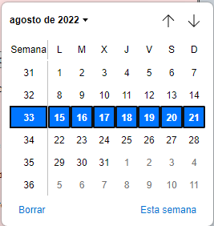









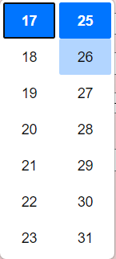
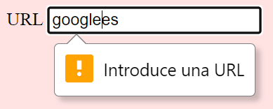
NUEVOS INPUTS
Tipos de Inputs | Descripción | Visualización
Week | Define una semana y un año
Number | Define un campo de entrada para números
Password | Define un campo de contraseña
Radio | Define un botón de tipo radio
Range | Define un rango de control
Reset | Define un botón de reseteo de los inputs dentro de un formulario (form)
Search | Define un texto para introducir un String de búsqueda
Submit | Define un botón de envío (submit)
Tel | Define un teléfono
Time | Define una hora
URL | Define un campo para la entrada de un URL

Slide 11
ATRIBUTOS INPUTS
2
RESPECTO A VERSIONES ANTERIORES DE HTML

Slide 12
ATRIBUTOS DE INPUTS
Tipos de Inputs | Descripción
Value | Especifica un valor inicial para un campo de entrada. (Útil para PHP)
Autofocus | Especifica que el valor deebe tener automaticamente el foco cuando la página cargue
List | Atributo que se refiere a <datalist> y contiene todas las opciones predefinidas de un input
Readonly | Especifica que un [input] es solo de lectura
Disabled | Especifica que un [input] esté desabilitado
Size | Especifica el ancho de un campo en función de los caracteres para un [input] por defecto son 20 (Funciona con text, search, tel, url, email y password)
Maxlength | Especifica el número máximo de caracteres
Min | Especifica el mínimo de valores
Max | Especifica el máximo de valores
Pattern | Especifica una expresión resgular que comprobará cada vez que se haga un submit
Placeholder | Especifica una breve sugerencia que describe el valor esperado de un [input]
Requiered | Especifica que el [input] debe ser rellenado obligatoriamente
Step | Especifica los intervalos de los números

Slide 13
FORM
3
CARACTERÍSTICAS, ATRIBUTOS

Slide 14
FORM CARACTERÍSTICAS
FORM ATRIBUTOS | EJEMPLO | DESCRIPCIÓN
ACTION | <form method="POST" action="/Pagina1.html“> | Especifica donde enviar los datos del formulario cuando se envía el formulario.
NAME | <form name="formulario" > | Especifica el nombre del formulario
NOVALIDATE | <form novalidate > | Especifica que el formulario no debería ser validado cuando envíe los datos (por ende, no comprabará requisitos mínimos, patterns etc...)
AUTOCOMPLETE=“ON“ // “OFF" | <form autocomplete="on"> || <form autocomplete="off"> | Especifica si un formulario debe autocompletarse o no
METHOD | <form method=“post" > | Especifica el método que usará para el envío de datos
TARGET | <form target="_blank"> | Especifica donde se mostrará la respuesta después de enviar el formulario [_blank] [_self] [_top] [_parent]
ENCTYPE | <form enctype="multipart/form-data"> | Especifica si los datos del formulario deberían enviarse codificados al servidor (Solo con el método post) [text/plain | multipart/form-data | | application/x-www-form-urlencoded]
REL | <form action="https://google.com" rel="external noreferrer" | Los datos del formulario son enviados a una URL externa [nofollow | noopener | noreferrer | external | author | help | license | prev | next | bookmark | search | alternate | tag ]

Slide 15
FORM CARACTERÍSTICAS
ESPECIFICACIONES REL
ESPECIFICACIONES ENCTYPE
VALUE | DESCRIPTION
nofollow | Specifies the link is not endorsed or is not controlled by the current page's author. Search engines often ignore links flagged as nofollow.
noopener | No context or information about the current page is sent to the linked page. Used for untrusted links to avoid tampering with the current page.
noreferrer | Prevents the browser from sending referrer data about the current page.
external | Indicates the link is to a page outside the current site (different domain). Applies to: a, area, form
help | Specifies the link is to a help page.
license | Specifies the link is to a page with licensing information.
prev | Specifies the previous page in a series of pages.
next | Specifies the next page in a series of pages.
search | Specifies the link is to a search page for the current page.
VALUE | DESCRIPTION
application/x-www-form-urlencoded | The default. All form data characters are encoded before sending to the server.
multipart/form-data | Form data characters are encoded before sending to the server. This value should only be used for forms with file upload functionality, i.e. have an input type="file" element.
text/plain | Form data characters are not encoded, expect space characters are converted to a "+". This value should not be used, except for debugging purposes.
ESPECIFICACIONES TARGET
VALUE | DESCRIPTION
_self | Opens the page in the same tab/window. This is the default.
_blank | Opens the page in a new tab.
_parent | Opens the page in the parent iframe. In the same iframe if there is no parent.
_top | Opens the page in the topmost part of the iframe. In the same iframe if there is no topmost.
framename | Opens the page in a named iframe.

Slide 16
EVENTOS HTML
3
RESPECTO A VERSIONES ANTERIORES DE HTML

Slide 17
ATRIBUTOS DE INPUTS
WINDOWS EVENTS ATTRIBUTES
FORM EVENTS
Tipos de Inputs | Descripción
onafterprint | Script to be run after the document is printed
onbeforeprint | Script to be run before the document is printed
onbeforeunload | Script to be run when the document is about to be unloaded
onerror | Script to be run when an error occurs
onhashchange | Script to be run when there has been changes to the anchor part of the a URL
onload | Fires after the page is finished loading
onmessage | Script to be run when the message is triggered
onoffline | Script to be run when the browser starts to work offline
ononline | Script to be run when the browser starts to work online
onpagehide | Script to be run when a user navigates away from a page
onpageshow | Script to be run when a user navigates to a page
onpopstate | Script to be run when the window's history changes
onresize | Fires when the browser window is resized
onstorage | Script to be run when a Web Storage area is updated
onunload | Fires once a page has unloaded (or the browser window has been closed)
onafterprint | Script to be run after the document is printed
onbeforeprint | Script to be run before the document is printed
Tipos de Inputs | Descripción
onblur | Fires the moment that the element loses focus
onchange | Fires the moment when the value of the element is changed
oncontextmenu | Script to be run when a context menu is triggered
onfocus | Fires the moment when the element gets focus
oninput | Script to be run when an element gets user input
oninvalid | Script to be run when an element is invalid
onreset | Fires when the Reset button in a form is clicked
onsearch | Fires when the user writes something in a search field (for <input="search">)
onselect | Fires after some text has been selected in an element
Onsubmit | Fires when a form is submitted
Tipos de Inputs | Descripción
oncopy | Fires when the user copies the content of an element
oncut | Fires when the user cuts the content of an element
onpaste | Fires when the user pastes some content in an element
CLIPBOARD EVENTS

Slide 18
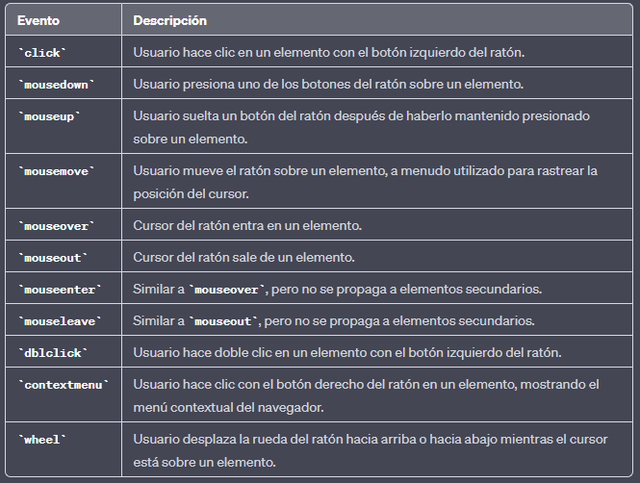
ATRIBUTOS DE INPUTS
MOUSE EVENTS
DRAG EVENTS
Tipos de Inputs | Descripción
ondrag | Script to be run when an element is dragged
ondragend | Script to be run at the end of a drag operation
ondragenter | Script to be run when an element has been dragged to a valid drop target
ondragleave | Script to be run when an element leaves a valid drop target
ondragover | Script to be run when an element is being dragged over a valid drop target
ondragstart | Script to be run at the start of a drag operation
ondrop | Script to be run when dragged element is being dropped
onscroll | Script to be run when an element's scrollbar is being scrolled
Tipos de Inputs | Descripción
onkeydown | Fires when a user is pressing a key
onkeypress | Fires when a user presses a key
onkeyup | Fires when a user releases a key
Tipos de Inputs | Descripción
ontoggle | Fires when the user opens or closes the <details> element
MISC EVENTS
KEYBOARD EVENTS

Slide 19
ATRIBUTOS DE INPUTS
MEDIA EVENTS
Tipos de Inputs | Descripción
onabort | Script to be run on abort
oncanplay | Script to be run when a file is ready to start playing (when it has buffered enough to begin)
oncanplaythrough | Script to be run when a file can be played all the way to the end without pausing for buffering
oncuechange | Script to be run when the cue changes in a <track> element
ondurationchange | Script to be run when the length of the media changes
onemptied | Script to be run when something bad happens and the file is suddenly unavailable (like unexpectedly disconnects)
onended | Script to be run when the media has reach the end (a useful event for messages like "thanks for listening")
onerror | Script to be run when an error occurs when the file is being loaded
onloadeddata | Script to be run when media data is loaded
onloadedmetadata | Script to be run when meta data (like dimensions and duration) are loaded
onloadstart | Script to be run just as the file begins to load before anything is actually loaded
onpause | Script to be run when the media is paused either by the user or programmatically
Tipos de Inputs | Descripción
onplay | Script to be run when the media is ready to start playing
onplaying | Script to be run when the media actually has started playing
onprogress | Script to be run when the browser is in the process of getting the media data
onratechange | Script to be run each time the playback rate changes (like when a user switches to a slow motion or fast forward mode)
onseeked | Script to be run when the seeking attribute is set to false indicating that seeking has ended
onseeking | Script to be run when the seeking attribute is set to true indicating that seeking is active
onstalled | Script to be run when the browser is unable to fetch the media data for whatever reason
onsuspend | Script to be run when fetching the media data is stopped before it is completely loaded for whatever reason
ontimeupdate | Script to be run when the playing position has changed (like when the user fast forwards to a different point in the media)
onvolumechange | Script to be run each time the volume is changed which (includes setting the volume to "mute")
onwaiting | Script to be run when the media has paused but is expected to resume (like when the media pauses to buffer more data)

Slide 20
EJEMPLOS HTML
3
INCLUYE TODOS LOS CASOS VISTO EN LA PRESENTACIÓN.
ESTARÁN TAMBIÉN DISPONIBLES LAS PÁGINAS WEB DE PRUEBAS PARA PODER ENTENDER MEJOR EL CÓDIGO

Slide 21
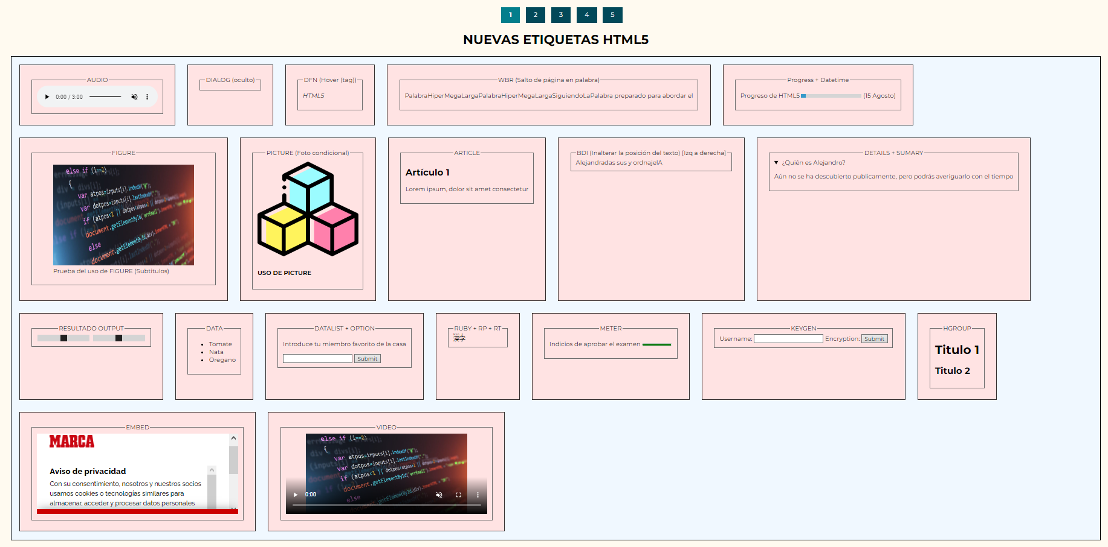
EJEMPLOS

Slide 22
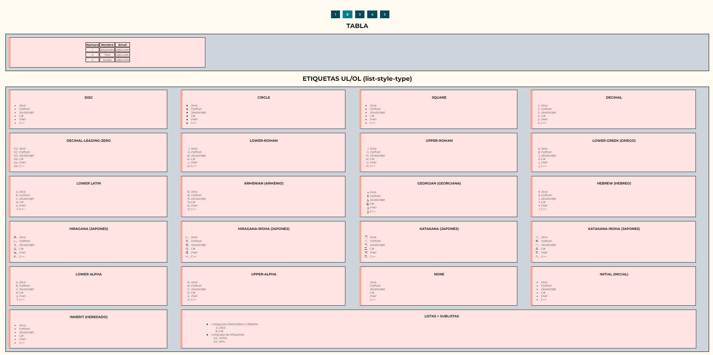
EJEMPLOS

Slide 23
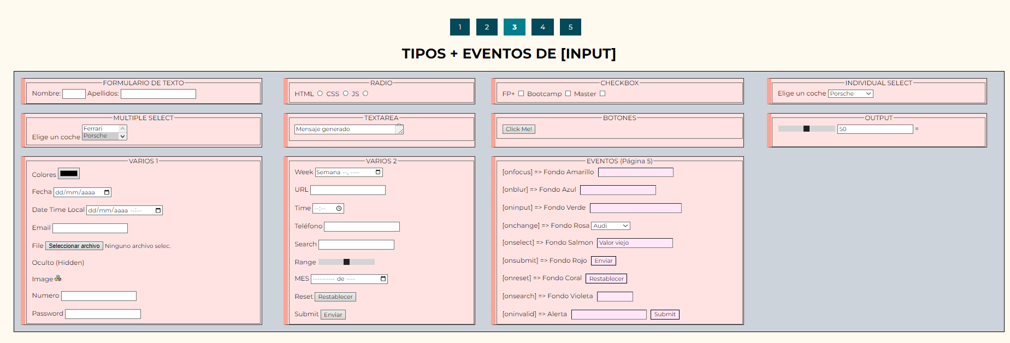
EJEMPLOS

Slide 24
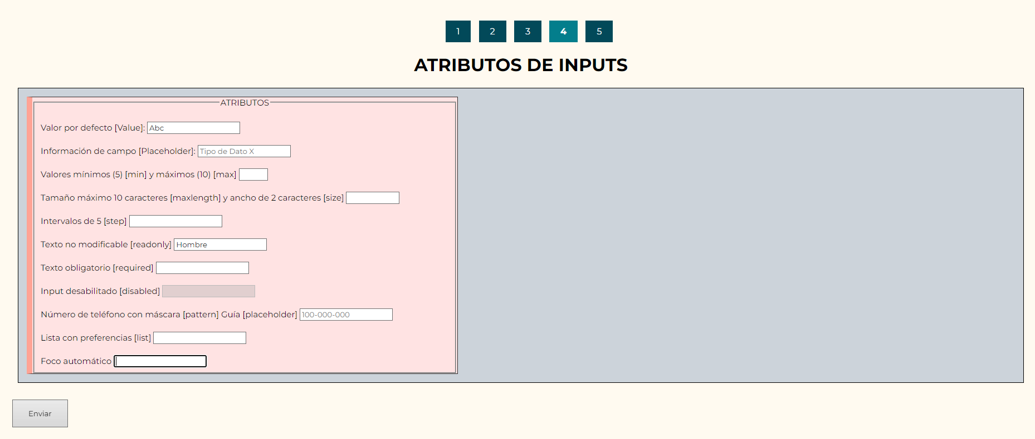
EJEMPLOS

Slide 25
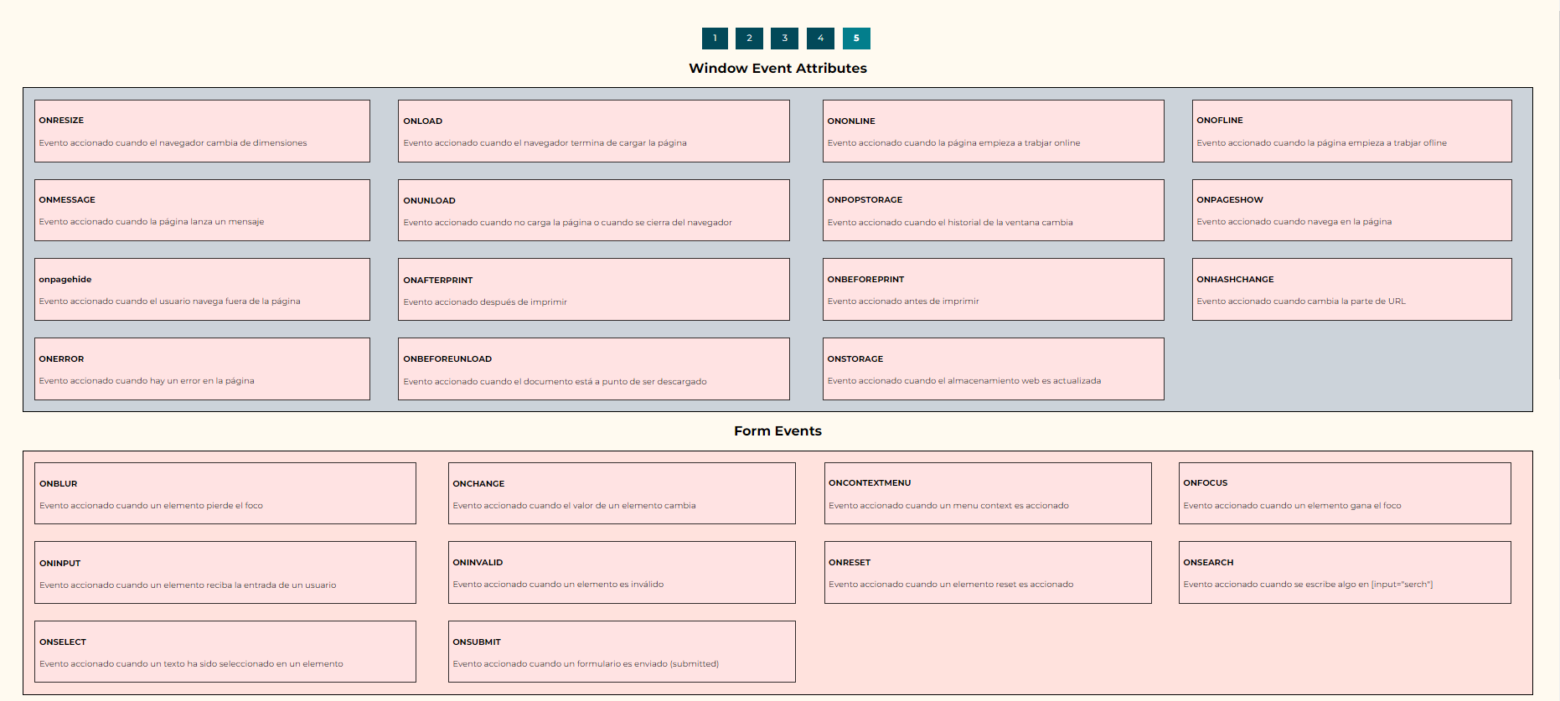
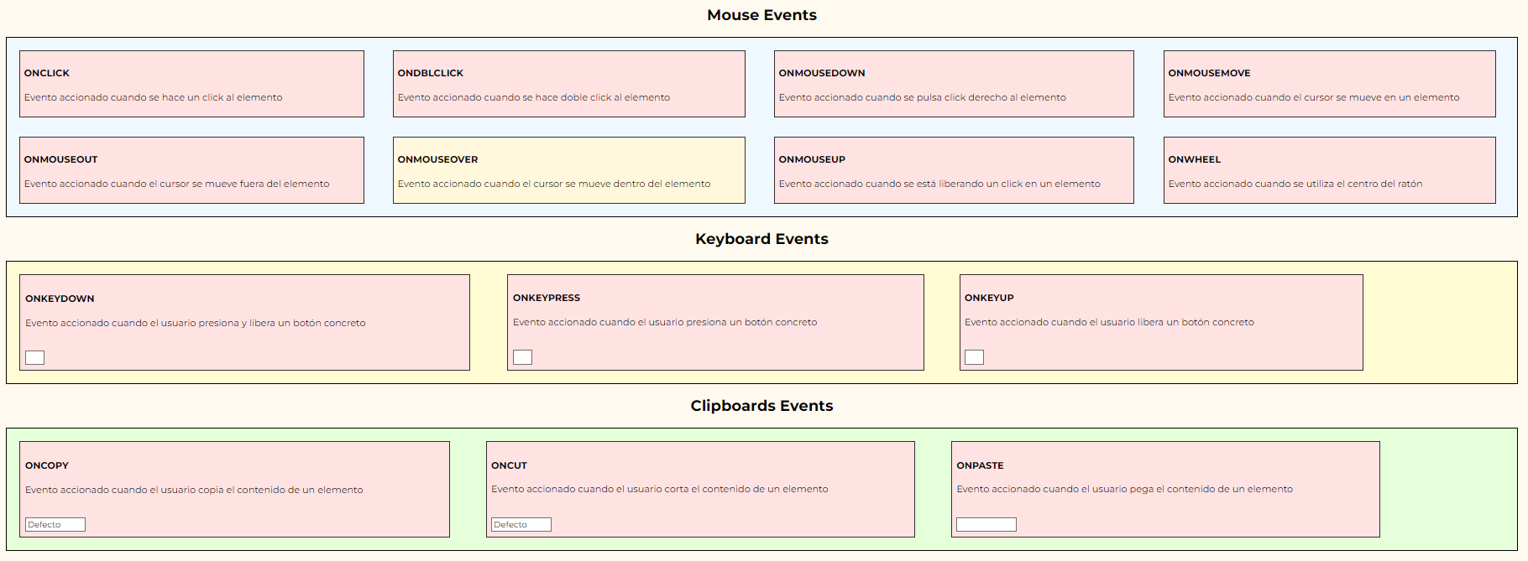
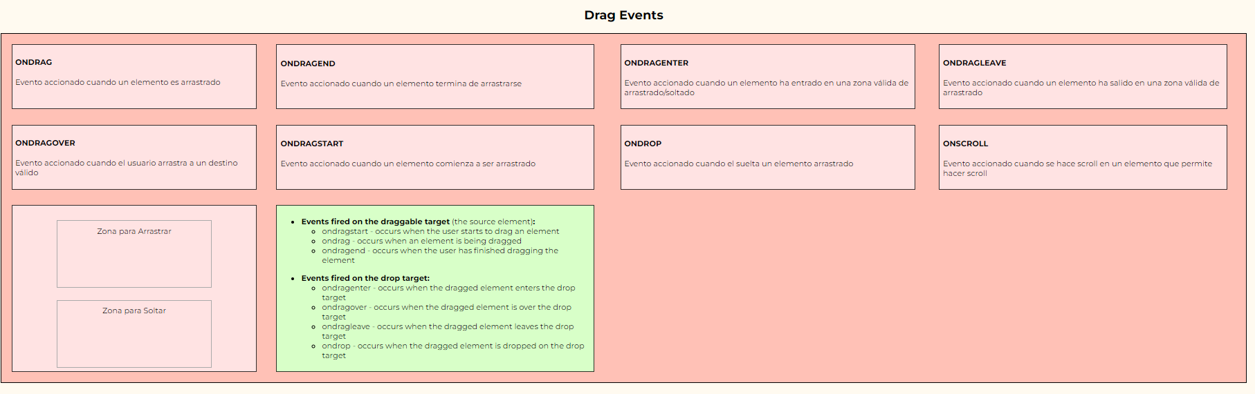
EJEMPLOS

Slide 26
ACTUALIZACIONES DE TEMARIO
3
DOCUMENTACIÓN DE LAS ACTUALIZACIONES REALIZADAS POSTERIORES A LA CREACIÓN DEL ARCHIVO
…

Slide 27
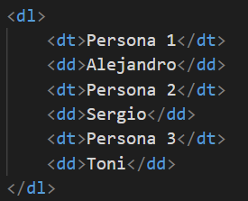
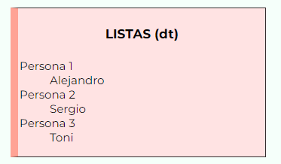
ACTUALIZACIONES
ETIQUETA | DESCRIPCIÓN
Dl | Define una descrpicón de lista
Dt | Indica los términos dentro de la lista
Dd | Detalles de los términos

